Slide 1

NETFLIX DATASET ANALYSIS
Gunamoni Manikanta
INTERNSHIP_172663295366ea53f910591

Slide 2

PROBLEM STATEMENT
Netflix has become one of the most prominent global streaming platforms, continuously expanding its library with a mix of original productions and licensed content. However, with growing competition from platforms like Amazon Prime, Disney+, and regional OTT providers, Netflix must strategically analyze its content catalog to identify strengths, gaps, and opportunities.

Slide 3
Project Description This project analyzes a dataset of 7,789 Netflix titles (2008–2021) with 11 attributes, including Title, Director, Cast, Country, Release Date, Rating, Duration, Category, and Genre. The goal is to study content trends, identify viewer preferences, and recommend strategies for Netflix’s future growth.

Slide 4

WHO ARE THE END USERS?
Netflix Management & Strategy Teams → For decision-making on content acquisition
Content Creators & Producers → To identify popular genres and trends
Market Analysts → To track OTT competition trends
Students/Researchers → For learning data analysis and visualization

Slide 5

Technology Used
Programming Language: Python – for data cleaning, analysis, and visualization.
Data Analysis Libraries: Pandas – for data manipulation and preprocessing. NumPy – for numerical operations and calculations.
Data Visualization Libraries: Matplotlib – for bar charts, line plots, and regression plots. Seaborn – for advanced statistical visualizations like boxplots and heatmaps. Plotly Express – for interactive visualizations (optional).
Development Environment: Jupyter Notebook / Google Colab – for coding and visualization.

Slide 6
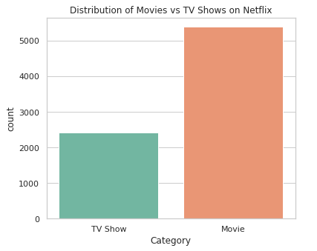
RESULTS1
Demo Link

Slide 7
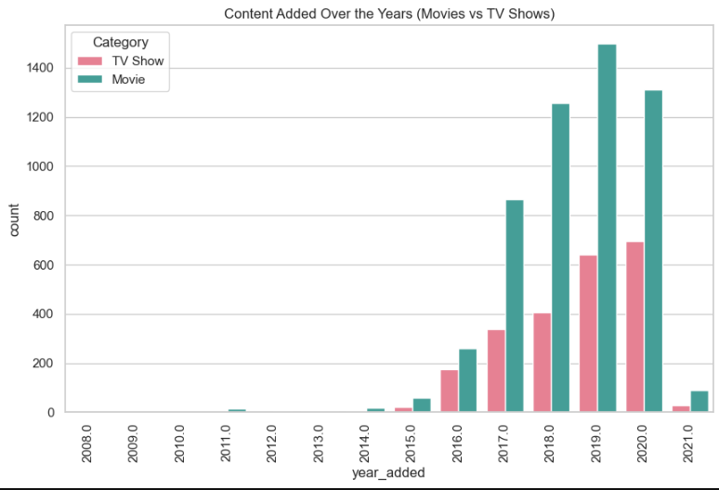
RESULTS2
Demo Link

Slide 8
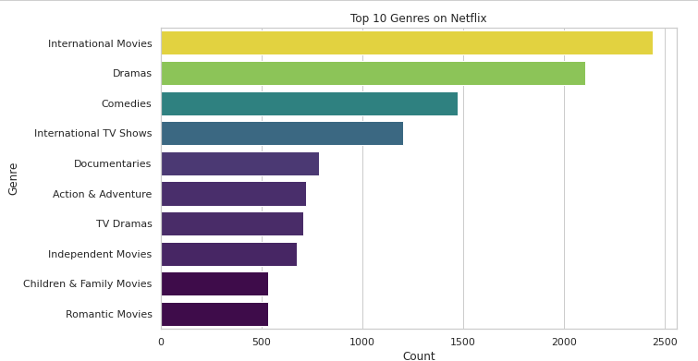
RESULTS3
Demo Link

Slide 9
GitHub repository
https://github.com/Manikantagunamoni/VOIS_AICTE_Oct2025_MajorProject_GunamoniManikanta
Demo Link

Slide 10

Getting started with Basics of Python Certificate

Slide 11

Data Visualization Certificate

Slide 12
Thank you
.
.

